Slide 1

Microsoft Entra Permissions Management
Automation and Alerts
<Name>
<Job role>

Slide 2
Agenda
Remediation Phase (Continued)
Day 60
Alerting
Day 90
Automation
Autopilot
Automated Reports
Next Steps

Slide 3

Day 60 Remediations (continued): Set up Alerting

Slide 4
Alert Types
Rule Based
Activity taking place for the first time
Statistical Anomaly Based
Tasks with unusual number, results, timing or types
Permissions Analytic Based
Any of the findings from the Permissions Analytics Report
Activity Based
Customizable logic rules. Ex: (Any failure on this crown jewel resource)

Slide 5
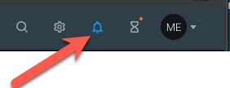
Recommended Alerts
Click the bell icon in the upper right corner of the Permissions Management portal to access the alerting menu

Slide 6
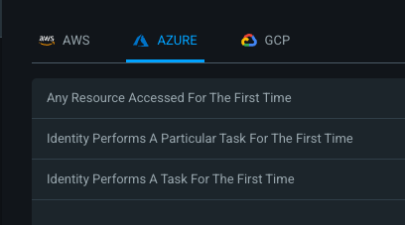
Recommended Alerts – Rule-Based Anomaly
Click the bell icon in the upper right corner of the Permissions Management portal to access the alerting menu
There are 3 types of rule-based anomaly triggers:

Slide 7
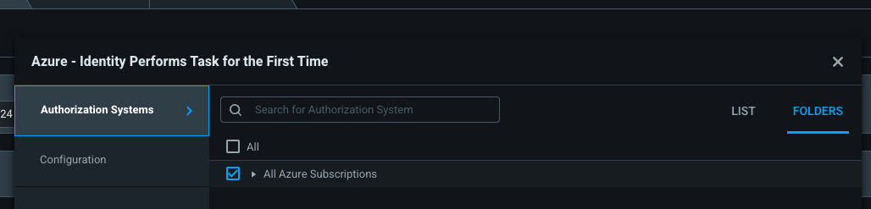
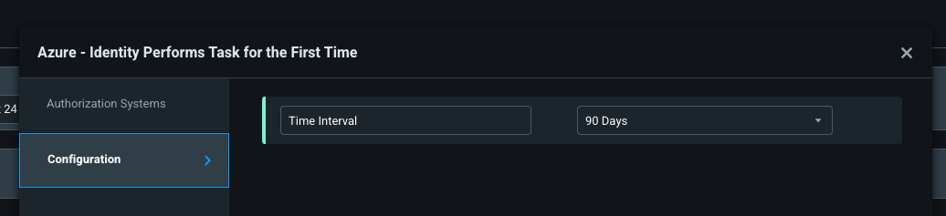
Recommended Alerts – Rule-Based Anomaly
Choose the rule type you’d like to create. Recommended to start with ”Identity Performs Task for the First Time”
Choose your authorization system(s)
Choose the time period to evaluate:

Slide 8
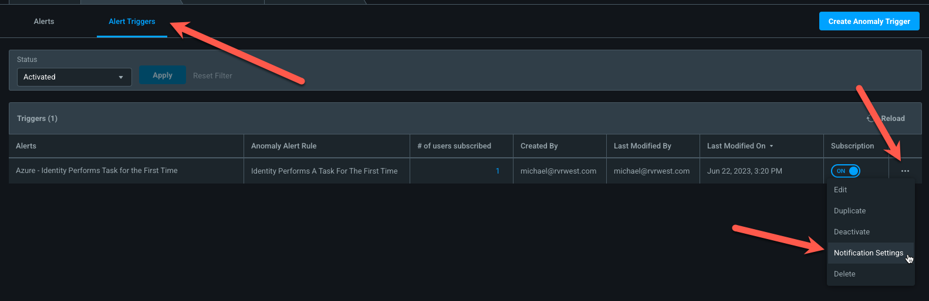
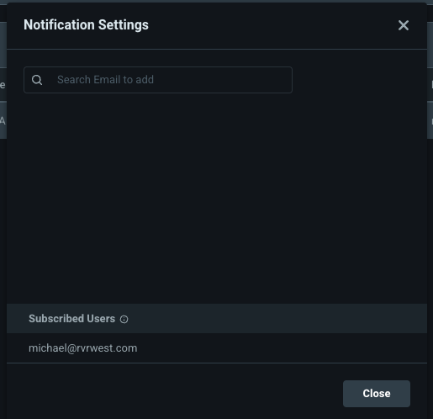
Recommended Alerts – Rule-Based Anomaly
Go to the Alert Triggers tab, click on the 3 dots menu on your new trigger, and choose Notification Settings:
Choose which admins should receive the alerts:
Repeat the process for other authorization systems

Slide 9
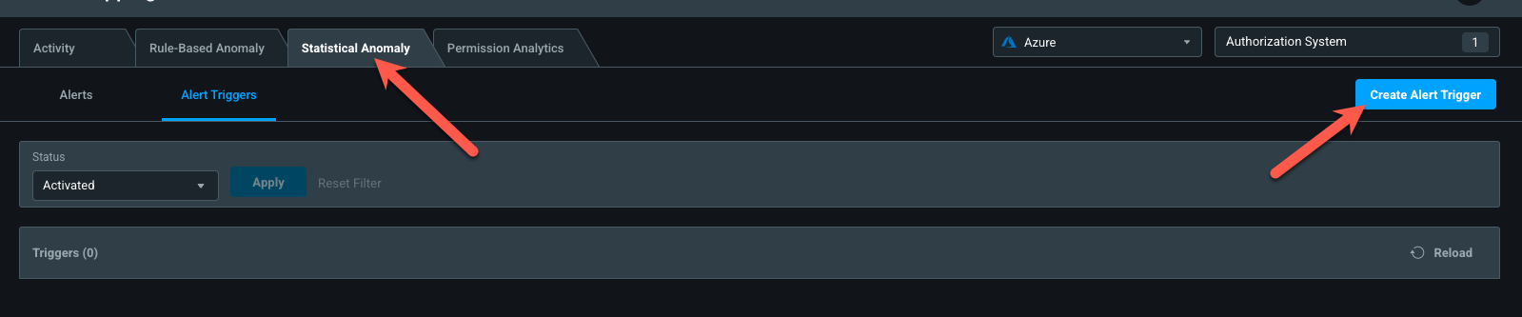
Recommended Alerts – Statistical Anomaly
Go to the Statistical Anomaly tab, Alert Triggers, and choose Create Alert Trigger:

Slide 10
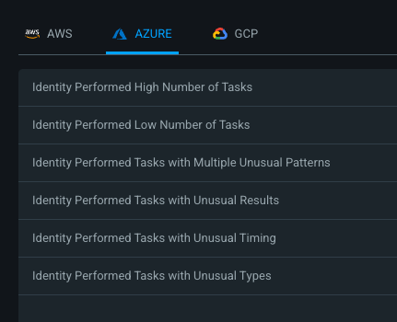
Recommended Alerts – Statistical Anomaly
Go to the Statistical Anomaly tab, Alert Triggers, and choose Create Alert Trigger:
There are 6 kinds of Statistical Anomaly Alerts you can create. Recommended to start with these:
Identity Performed High Number of Tasks
Identity Performed Tasks with Multiple Unusual Patterns
Identity Performed Tasks with Unusual Results
Identity Performed Tasks with Unusual Timing
Identity Performed Tasks with Unusual Types

Slide 11
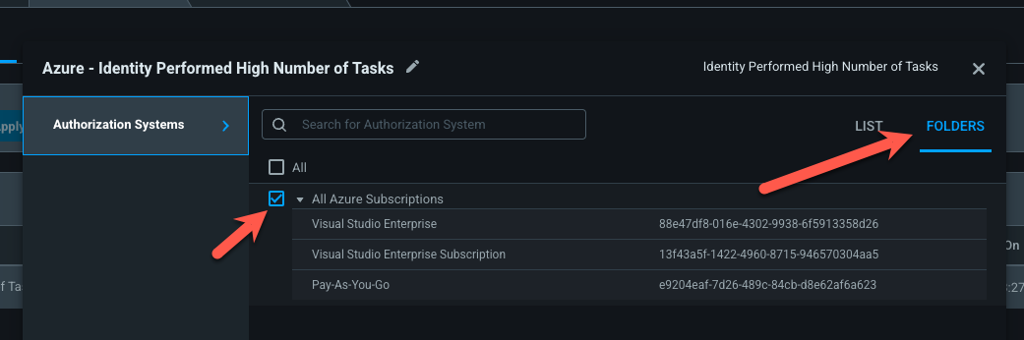
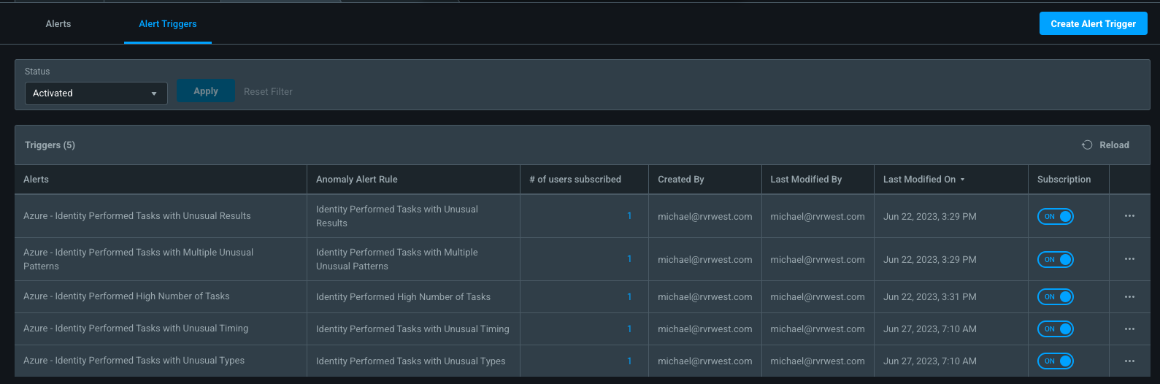
Recommended Alerts – Statistical Anomaly
It's recommended that you set up your alert triggers based on folders rather than picking and choosing individual subscriptions
When completed, you should have at least 5 alert triggers:

Slide 12
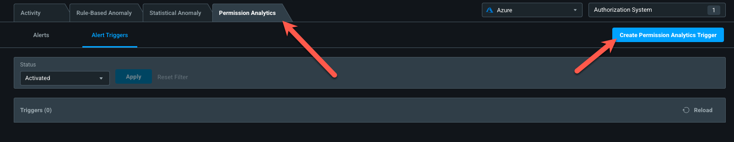
Recommended Alerts – Permissions Analytics
Go to the Permission Analytics tab, Alert Triggers, and choose Create Alert Trigger:

Slide 13
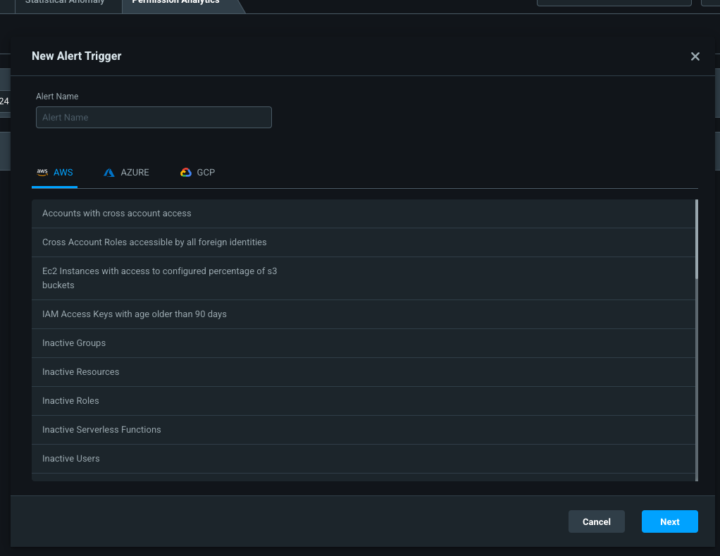
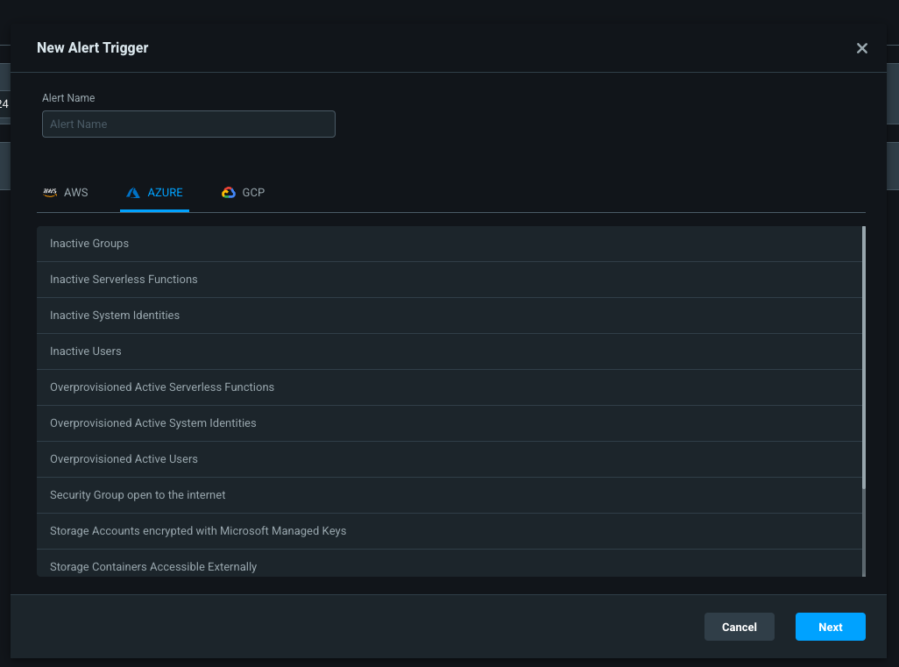
Recommended Alerts – Permissions Analytics
There are different permissions analytics for AWS, Azure, and GCP
Create the alerts on the following pages for each provider, to start

Slide 14
Recommended Alerts – Permissions Analytics
Recommended initial set of alerts, start here at minimum, add additional Permissions Analytics alerts depending on need:
AWS
Azure
GCP
Overprovisioned Active Roles
Overprovisioned Active Users
Roles with Privilege Escalation
Service Accounts with Privilege Escalation
Super Roles
Super Users
Users with Privilege Escalation
(Optional, depending on use of IDP for MFA) User with no MFA
Overprovisioned Active System Identities
Overprovisioned Active Users
Super System Identities
Super Users
Overprovisioned Active Service Accounts
Overprovisioned Active Users
Service Accounts with Privilege Escalation
Super Service Accounts
Super Users
Users with Privilege Escalation

Slide 15
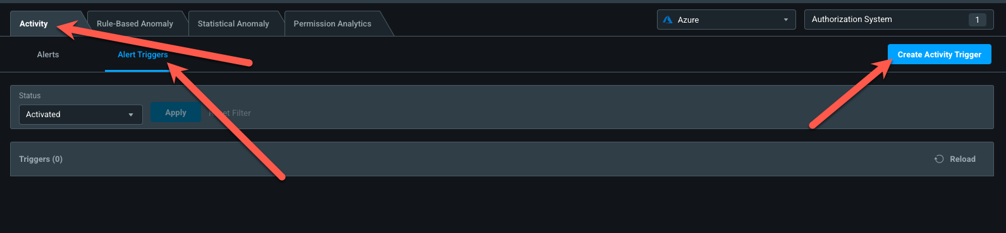
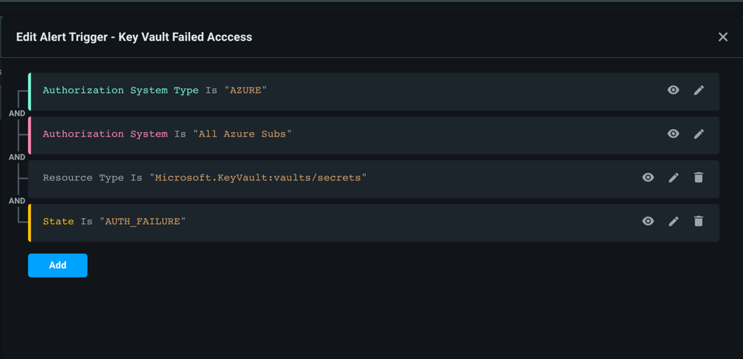
Recommended Alerts – Activity Alerts
Can customize which specific resources to generate alerts on
Resource Type
Resource Name
Task Name
Username
State
Authorization Failure, Error, Success
Focus on crown jewel type resources
Ex: Failure Access to KeyVault

Slide 16

Day 90 Remediations: Leverage Automation

Slide 17
Automation – Autopilot
Autopilot allows you to automate the right-sizing of permissions, remove unused roles, and remove unused role assignments / permissions
Rules are based on inactivity – remember that EPM has 90 days of activity data, so inactivity will be based on 90 days of usage or less
Available Rules
AWS-Delete Unused Roles
Azure-Remove Permissions For Unused Applications/Managed Identities
GCP-Remove Permissions for Unused ServiceAccounts

Slide 18
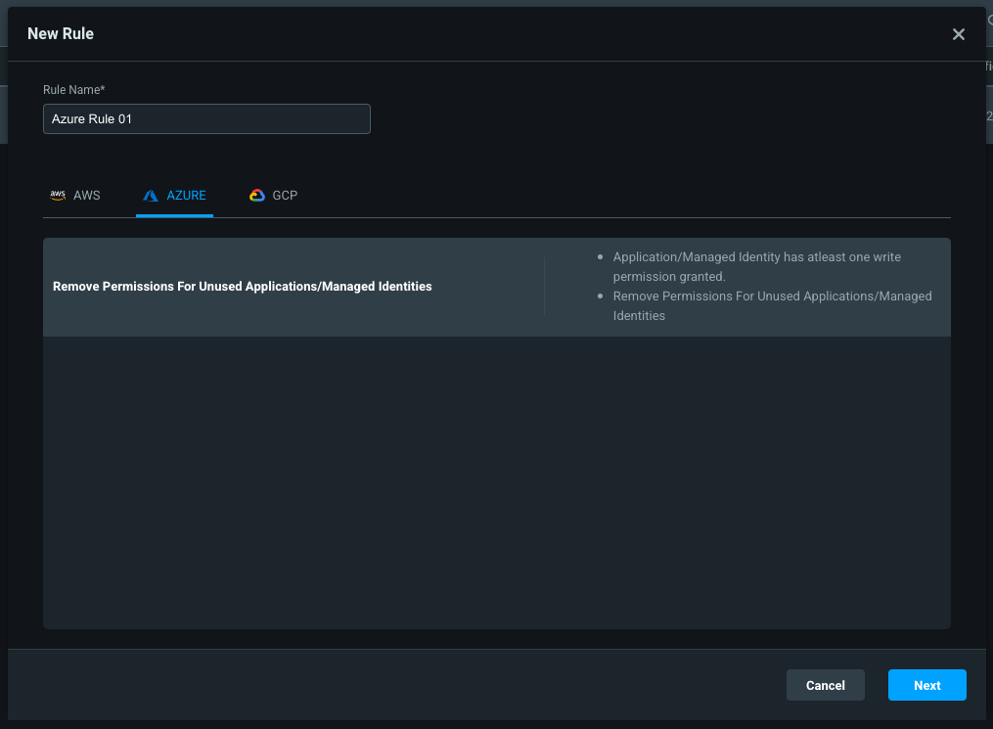
Recommended Autopilot Rule
Go to the Autopilot tab
Click the New Rule button
Select Azure as the auth system type
Provide a name and click Next

Slide 19
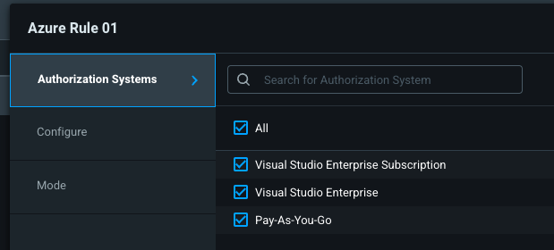
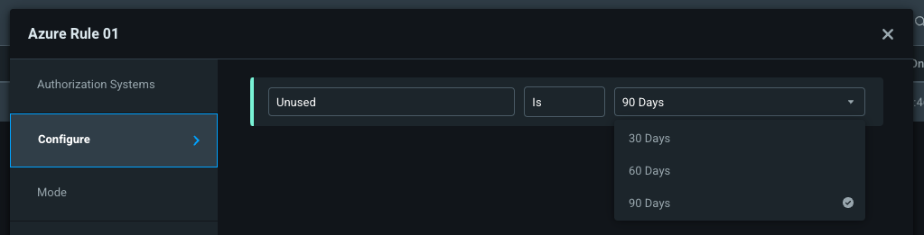
Recommended Autopilot Rule
Select your authorization system(s). You may select one or more than one
Choose the rule’s inactivity timer threshold

Slide 20
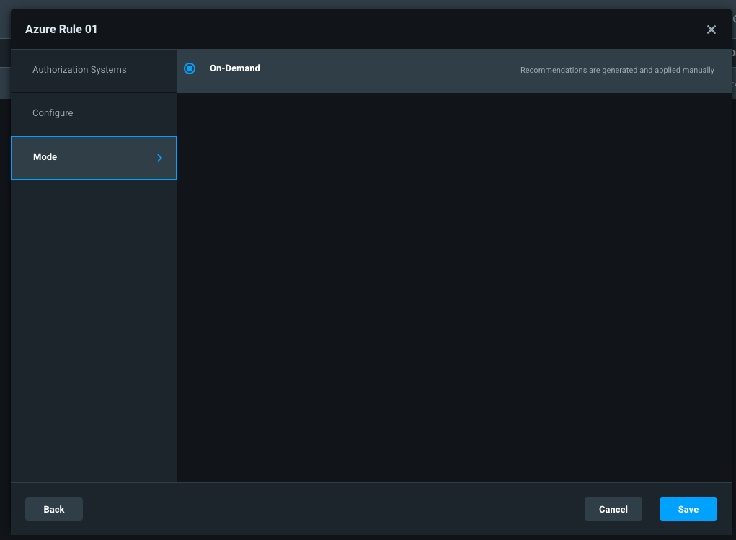
Recommended Autopilot Rule
Choose the mode, typically on-demand
Click Save
Repeat process for other authorization systems of same type or different types
Autopilot rules are slightly different between AWS, Azure, and GCP, but fundamentally do similar things

Slide 21
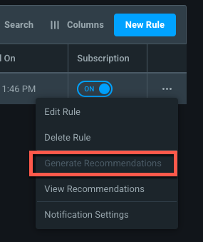
Recommended Autopilot Rule
Click the Generate Recommendations button on the 3 dots menu to kick off the recommendations process
If you onboarded EPM recently then no recommendations may be available for 30/60/90 days, depending on how you configured the Autopilot rule

Slide 22
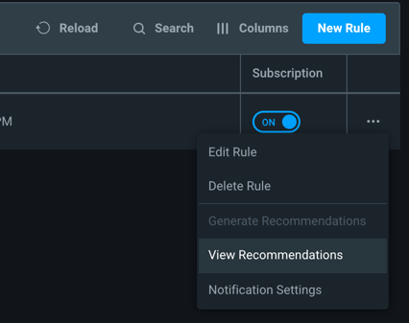
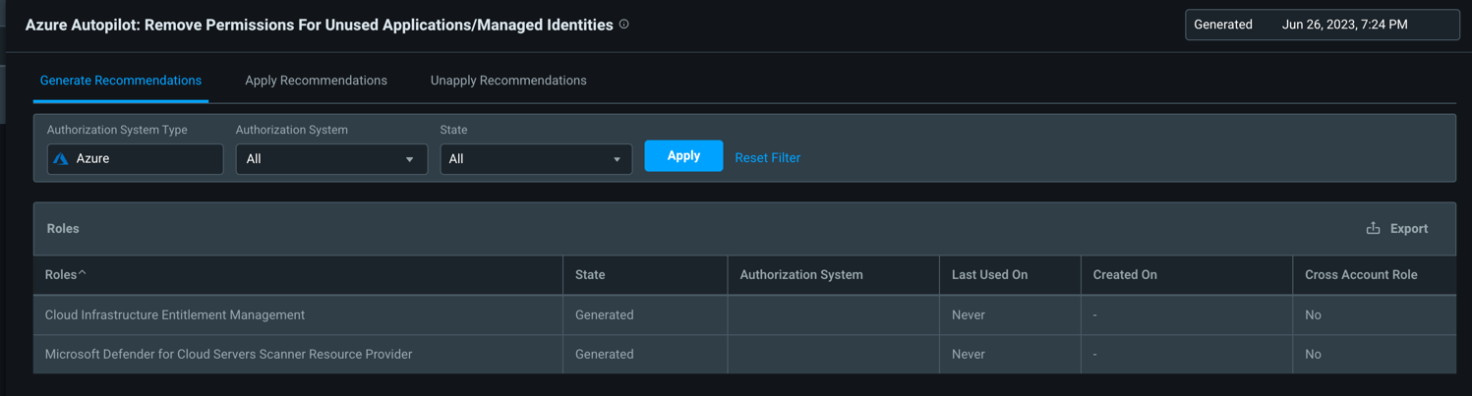
View Auto Pilot Recommendations
Click the View Recommendations button on the 3 dots menu.
The recommendations for that rule will be shown.
Example below these are the apps whose permissions would be removed

Slide 23
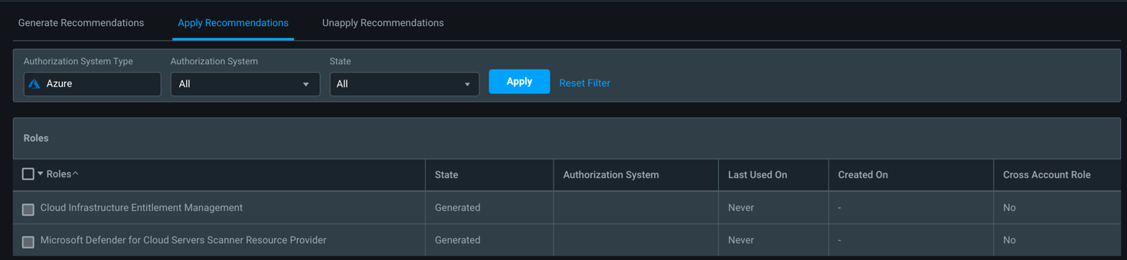
Apply Recommendations
After confirming the changes, check the box to which recommendation you want to apply, then hit ”Apply” button on bottom
Note: A Controller will need to be setup to be able to make changes in the Authorization System

Slide 24
Enable Scheduled Report Auto-Generation

Slide 25

Next Steps

Slide 26
Where do we go from here?
Finish remediating the most critical items found in the POC
SOC leverage data and alerts for investigation of incidents
JIT Privilege Elevation for critical resource access
Start to remediate most over permissioned users/groups/apps
Monitor PCI Score, did it go up or down?
Continue to use Entra Permissions Management
We’ll follow up in about 3 weeks
What did you like?
What needs to be improved?
What else did you find?
Would a roadmap conversation be helpful?

Slide 27

Thank you!

